Slide 1
Power BI

Slide 2
Power BI – Excel Integration
Using Excel Data:
Using Power BI , we can also import the Excel workbook file from the local drive into Power BI.
To import data from the excel sheet , we need to ensure that each column has a proper name.
To import an excel file in Power BI , navigate to Get Data -> Files -> Local Files.

Slide 3
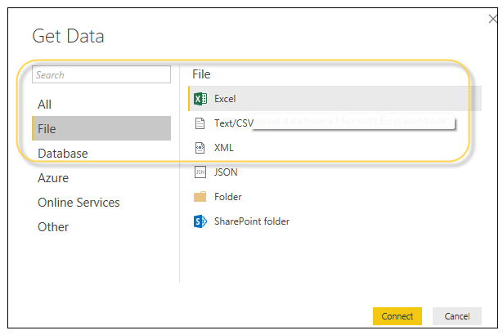
Power BI – Excel Integration

Slide 4
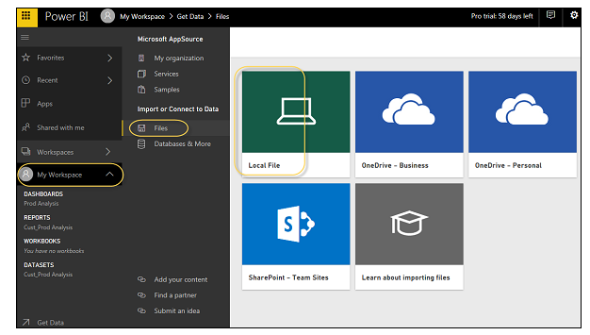
Power BI – Excel Integration
Importing xls files:
In Power BI service , navigate to My Workspace-> File -> Local File.

Slide 5
Power BI – Excel Integration
It is not necessary that the excel file should only be saved on the Local Drive.
We can also import an Excel workbook from OneDrive or even from SharePoint.
Once the dataset is imported , we are ready to create the reports in Power BI.
Imported dataset is available under “DATASETS” option in the Power BI menu.
Double – click Datasets.

Slide 6
Power BI – Excel Integration
Then , navigate to the Explore tab.
This will open a new Report Canvas.
All the fields from the table and the corresponding columns are available under the Fields option on the right side of the screen.

Slide 7
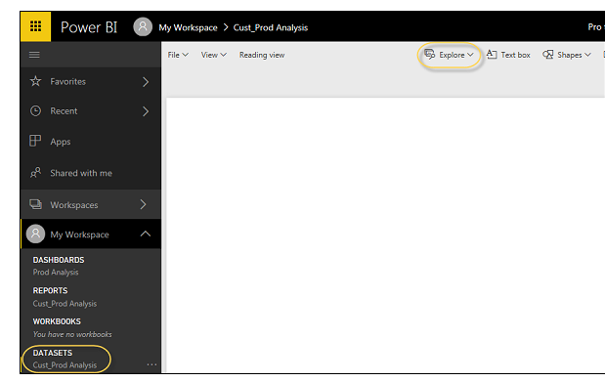
Power BI – Excel Integration

Slide 8
Power BI – Excel Integration
To create a report , select any visualization and add the fields from the table to the visualization.

Slide 9
Sharing Power BI DashBoards
Using Power BI Deskstop for Report Sharing:
Power BI reports can also be shared with other business users.
BI reports , dashboards and data can be shared other colleagues and business users in the organization.
We can share the reports using the following methods:
Publish reports using Power BI Service.
Content packs combine dashboard , report , and datasets obtained in
BI Desktop tool.

Slide 10
Sharing Power BI DashBoards
Create Groups and assign specific rights to different users for report sharing.
Use Power BI mobile apps to access share dashboards and reports.
Once the report is created , navigate to the Publish button on the Home tab in Power BI desktop.

Slide 11
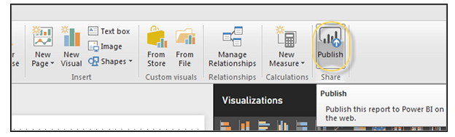
Sharing Power BI DashBoards

Slide 12
Sharing Power BI DashBoards
Once we select the Publish service , our visuals , custom measures and reports are all packaged and published to Power BI service.
Power BI files have an extension .pbix files.
When the upload is in process , we get a dialog box that Publishing is in process.

Slide 13
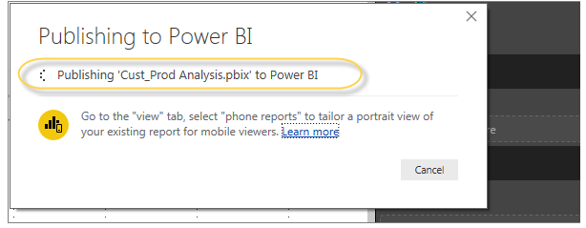
Sharing Power BI DashBoards

Slide 14
Sharing Power BI DashBoards
Once the upload is complete , we will get a confirmation message called “ Success”.
We can also view Quick Insights and open the shared report from the dialog box.

Slide 15
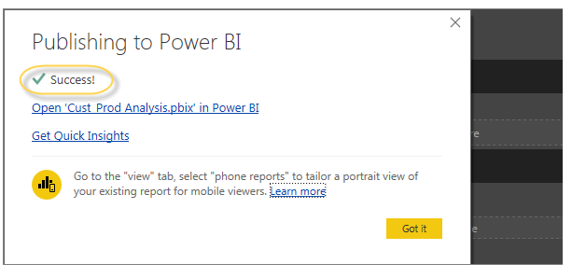
Sharing Power BI DashBoards

Slide 16
Sharing Power BI DashBoards
Printing Power BI Dashboards:
It is also required sometimes to take printouts of reports and dashboards.
Power BI can be used to take printouts of BI reports and dashboards.
To take printout of the report , navigate to Power BI service and click the “…” option.

Slide 17
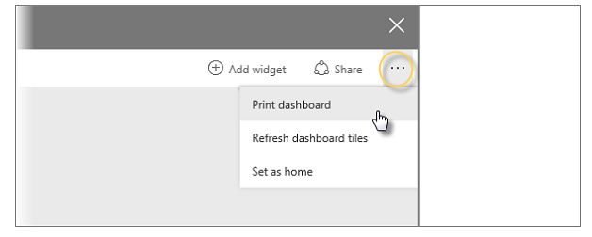
Sharing Power BI DashBoards

Slide 18
Sharing Power BI DashBoards
Printing Power BI Dashboards:
It will open a Print dialog box.
Select the printer on which we want to take the printout of the report.
We can also select several print options like Portrait/Landscape,
Margins , Header or Scale.

Slide 19
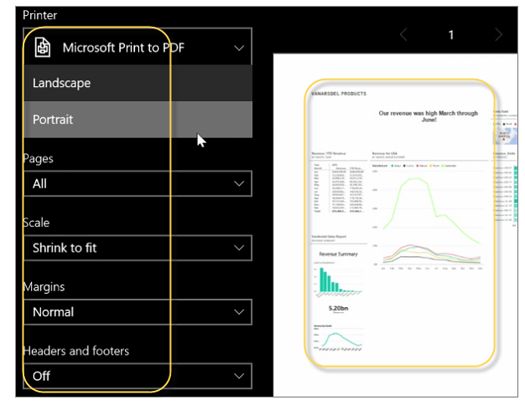
Sharing Power BI DashBoards

Slide 20
Sharing Power BI DashBoards
Export Options:
In Power BI , we can also use different Export options to export data from BI report.
To use the export option , navigate to Power BI service and select the BI report we want to export.

Slide 21
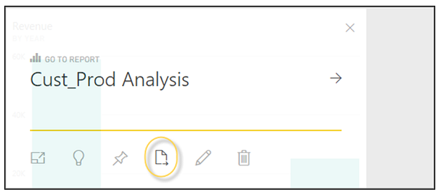
Sharing Power BI DashBoards

Slide 22
Sharing Power BI DashBoards

